Slide 2
January 11, 2023
1900

Slide 3
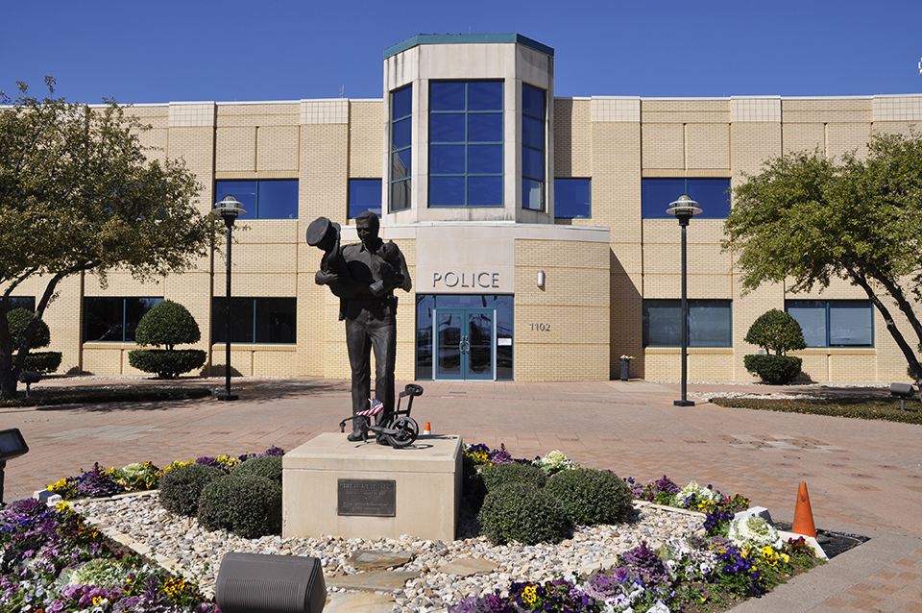
Thank You
Euless Police Department

Slide 4
Member Update

Slide 5
Introductions

Slide 6
Minutes

Slide 7
Treasurer’s Report

Slide 8
C.E.R.T Update

Slide 9
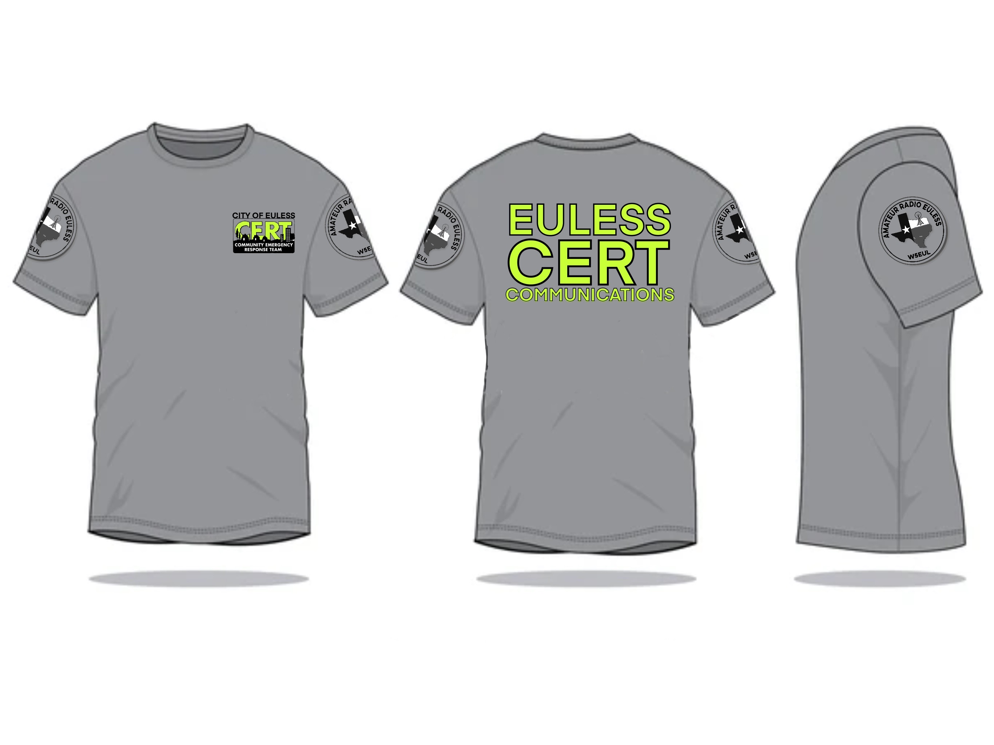
C.E.R.T Radio Shirt

Slide 10
Local Happenings

Slide 11
Euless ARC Gatherings
ERBC – Every Friday, @ 0830
Texan Kitchen 415 N Main, Euless, TX 76039
Club Social – Monday, January 16, 1800 – 1900
54th Street 2201 State HWY 121 S, Bedford, TX 76021

Slide 12
Tarrant County ARC Gatherings
Arlington ARC
First Saturday Breakfast, 0830 – 0930, Pioneer Restaurant, 306 109th St, Arlington, TX 76011
Cowtown ARC
“Saturday Ham Breakfast" We eat at various area restaurants about 0700 every Saturday morning. Check the "two-eight" repeater for the location and talk-in starting at 0600.
Hurst ARC
Every Saturday 0700 – 0830 Benny's Cafe, 4712 Colleyville Blvd #100, Colleyville, TX 76034
NRH ARC
Monthly board meetings are normally held on the Saturday before the fourth Monday of each month 0745 at Bacon's restaurant 714 Grapevine Hwy Hurst, Texas

Slide 13
Dallas County ARC Gatherings
Richardson Wireless Klub
Monthly RWK “Hungry Ham” Breakfast 3rd Saturday 0800,
Southern Recipes Grill 621 W Plano Pkwy, Unit 229, Plano, TX 75075
Metrocrest Amateur Radio Society
‘Ham and Eggs” Every Saturday Breakfast 0800-1100
Whataburger, 1033 E Trinity Mills Rd, Carrollton, TX 75006

Slide 14
Denton County ARC Gatherings
Lewisville ARA
LARA Breakfast Every Saturday 0800 – 0900
First Watch, 2201 Justin Rd Suite 301, Flower Mound, TX 75028
Lake Area Amateur Radio Klub
Saturday Breakfast 0800
Water’s Edge, 800 W Eldorado Pkwy, Unit 126, Little Elm, TX 75068

Slide 15
Upcoming Events
January
Skywarn NWS: Collin County Saturday January 14th 0830
Location: Sockwell Center
6301 Chapel Hill Blvd., Plano, TX 75093
Cowtown Hamfest: January 20-21
Winter Field Day January 28-29

Slide 16
Upcoming Events
February
Skywarn NWS: Tarrant County Saturday February 4th 0830
Location: Forest Hill Civic Center
6901 Wichita St., Forest Hill, TX 76140
Orlando Hamcation February 11-13, 2022 Orlando Florida www.hamcation.com
Skywarn NWS: Dallas County Saturday February 18th 0900
Location: Granville Arts Center; The Atrium
300 N. 5th St., Garland, TX 75040
Skywarn: NWS - Virtual
Tuesday, February 21st @ 1900
Cowtown Marathon: February 24-26
Skywarn NWS: Denton County Saturday February 25th 1000
Location: Texas Women's University, MCL Auditorium
1200-1242 N Bell Ave, Denton, TX 76209

Slide 17
Upcoming Events
March
Skywarn school: NWS - Virtual
Saturday, March 4th @ 0930
Irving Hamfest, March 5th, 0800 – 1400. 2400 W. Irving Blvd.
Skywarn school: NWS - Virtual
Tuesday, March 21st @ 1900
Online QSO Today Virtual Ham Expo, March 25 - 26 www.qsotodayhamexpo.com
RACES Renewal: TBD

Slide 18
What kind of club are we?

Slide 19
2022 Recap
Visibility
Charities
Tech class
Fox Hunt
Newsletter
Field Days
Scouting
Audit the Books

Slide 20
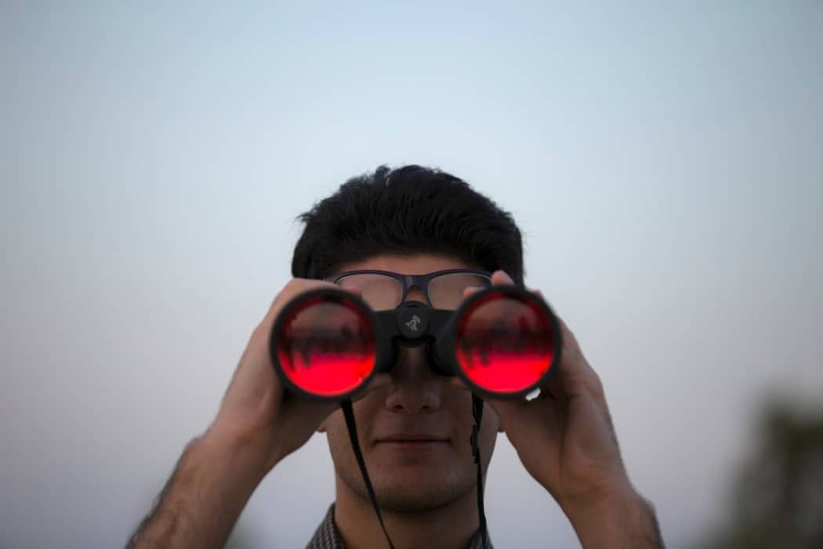
Visibility
Wearing our T-shirts
Radios in the Park
Volunteerism
Ideas/committee?

Slide 21
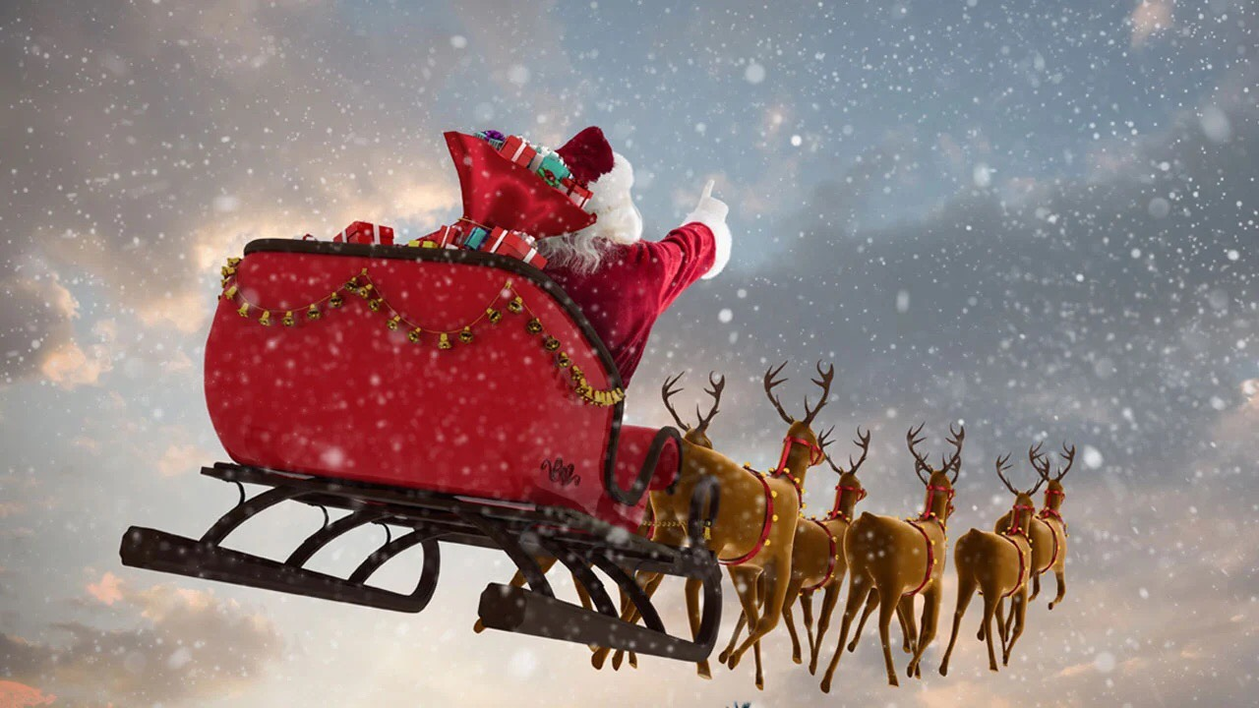
Charities
One Charity at Christmas or more throughout the year?
Do we need a Charity Committee?

Slide 22
Tech Classes
Two formats: Original format mimicked CERT class, New format was two days only.
Last class was canceled due to not enough students or volunteers.
Thoughts, committee?

Slide 23
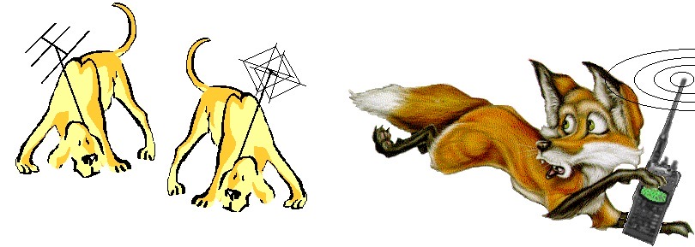
Fox Hunts
Fox Hunts: we had one and it was a blast.
Committee?

Slide 24
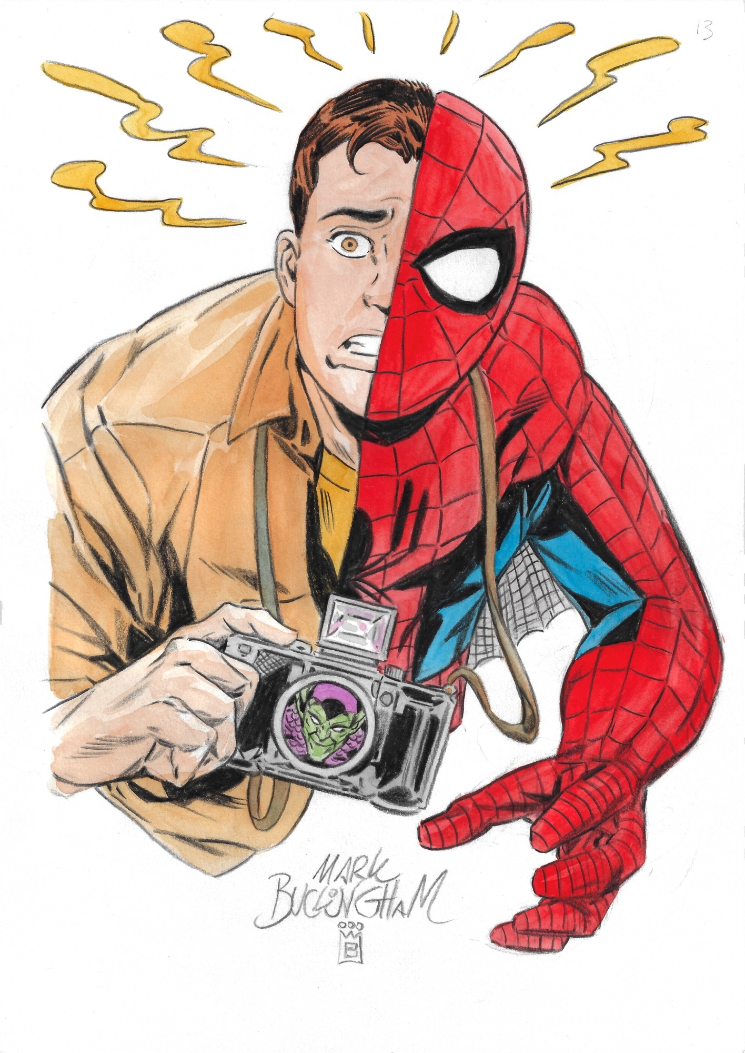
Newsletter
Jim has been making newsletters for the ERBC and the club meetings, if anybody would like to contribute, he would appreciate the help.

Slide 25
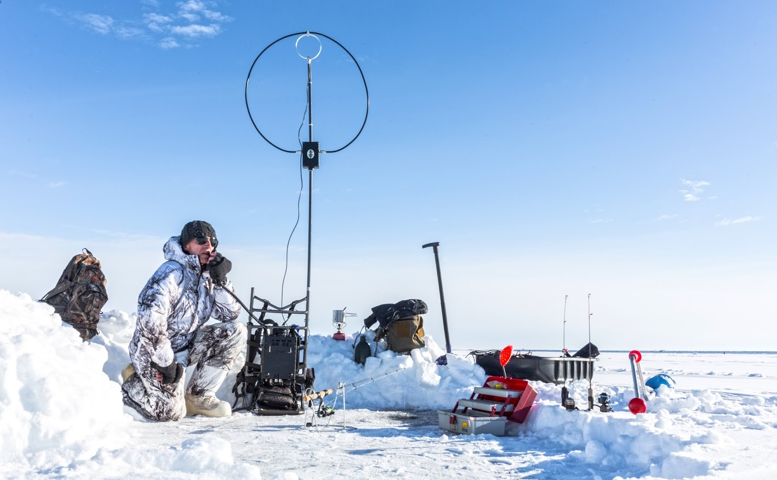
Winter Field Day
January 28-29

Slide 26
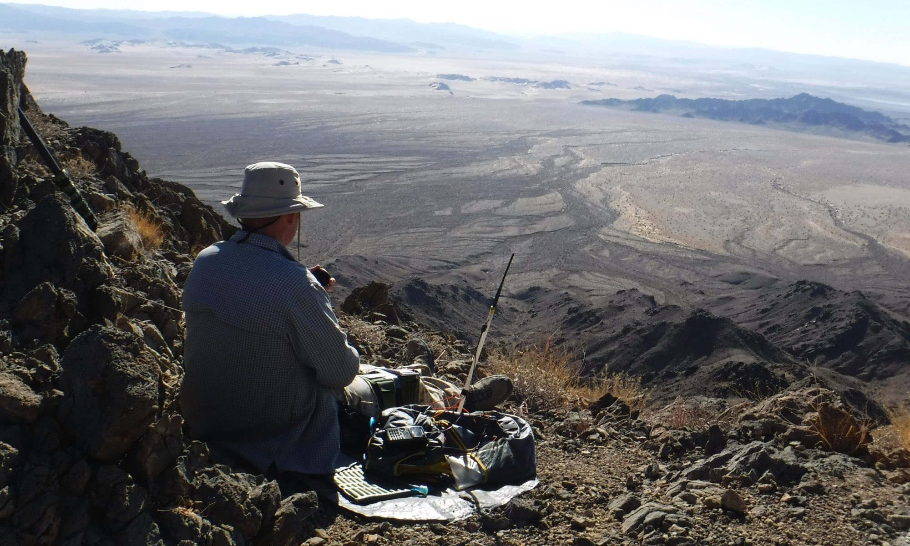
Field Day
June 24-25

Slide 27
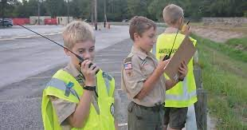
Scouting
Radio Merit Badge
Scouting Class

Slide 28
Audit Committee
2022 is behind us, time to crunch the numbers.
Audit Committee

Slide 29
What kind of club do
we want to be?

Slide 30
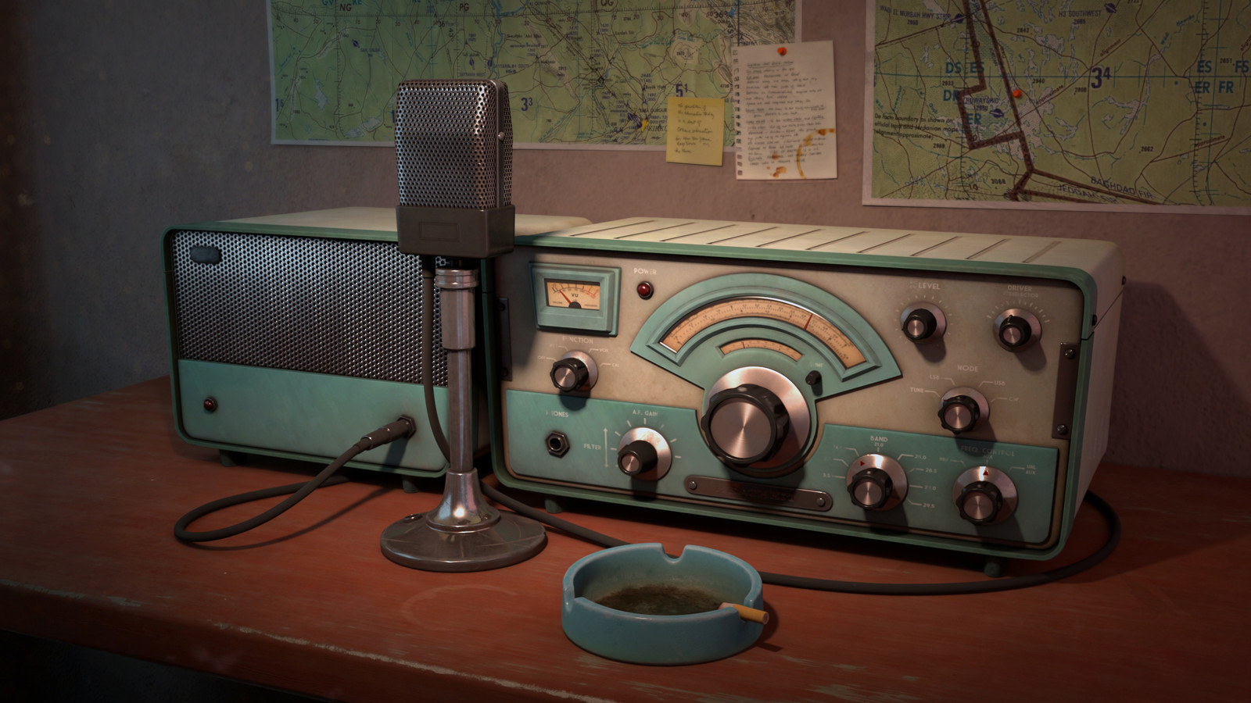
Erik
Greg
Chris
Members
Open Chat

Slide 31
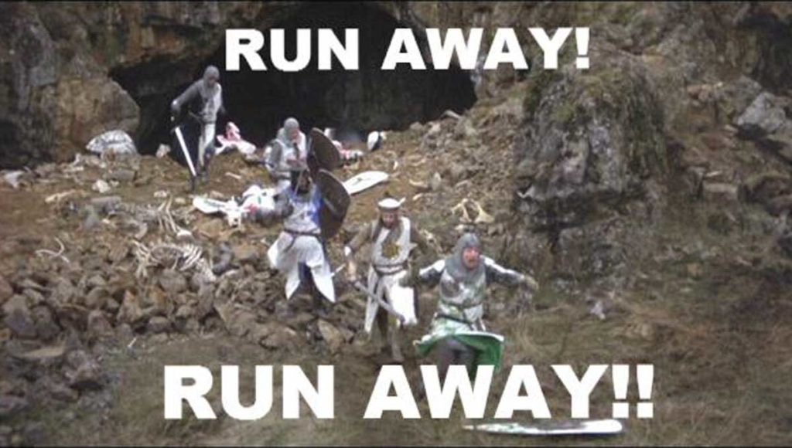
Motion To Adjourn

