Slide 2
March 8, 2023

Slide 3
Member Update

Slide 4
Introductions

Slide 5
Minutes

Slide 6
Treasurer’s Report

Slide 7
C.E.R.T Update

Slide 8
C.E.R.T Radio Shirt

Slide 9
C.E.R.T Radio Shirt

Slide 10
Local Happenings

Slide 11
Euless ARC Gatherings
ERBC – Every Friday, @ 0830
Texan Kitchen 415 N Main, Euless, TX 76039
Club Social – Monday, March. 20th 1800 – 1900
Spring Creek BBQ 1509 Airport FWY, Bedford, TX 76021

Slide 12
Upcoming Events
March
Greater Houston Hamfest,
March 3rd 1400 & 4th 0800
Skywarn school: NWS - Virtual
Saturday, March 4th @ 0930
Irving Hamfest, Mar. 5th, 0800 – 1400,
2400 W. Irving Blvd.

Slide 13
Upcoming Events
March
Upcoming Events
March
(Continued)
Fox Hunt - March 11th 0900
Starting point: City of Euless Aquatic Park.

Slide 14
Upcoming Events
March
(Continued)
Skywarn school: NWS - Virtual Tuesday, Mar. 21st @ 1900
Fort Worth: R.A.C.E.S. New members, March 25, FW EOC,
Online QSO Today Virtual Ham Expo, March 25 - 26 www.qsotodayhamexpo.com

Slide 15
Upcoming Events
April
Fort Worth R.A.C.E.S. Renewal,
April 4th, FW EOC,
Texas State Parks on the Air to Commemorate
Tom King, WK5DX, the Texas Event's Founder
Event Timing: April 15-16, 2023
Event Address: Anywhere your radio is!
Contact us at k5lrk.tx@gmail.com
https://www.tspota.org/home

Slide 16
Upcoming Events
April
(Continued)
World Amateur Radio Day
Tuesday, April 18th 0000 - Wednesday, April 19th 0000
Arbor Daze, Saturday, April 29th, Midway Park

Slide 17
Upcoming Events
May
Fort Worth R.A.C.E.S. Renewal,
April 4th, FW EOC,
Texas State Parks on the Air to Commemorate
Tom King, WK5DX, the Texas Event's Founder
Event Timing: April 15-16, 2023
Event Address: Anywhere your radio is!
Contact us at k5lrk.tx@gmail.com
https://www.tspota.org/home

Slide 18
Fox Hunts:
March 11 2023
Committee:
Chris Shanahan
Volunteer #2
Volunteer #3

Slide 19
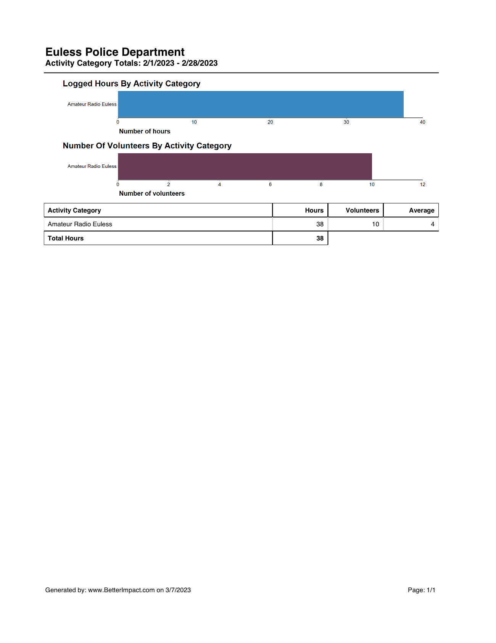
Volunteer Hours

Slide 20
Arbor Daze
April 29, 2023
Committee:
George Smith
Volunteer #2
Volunteer #3

Slide 21
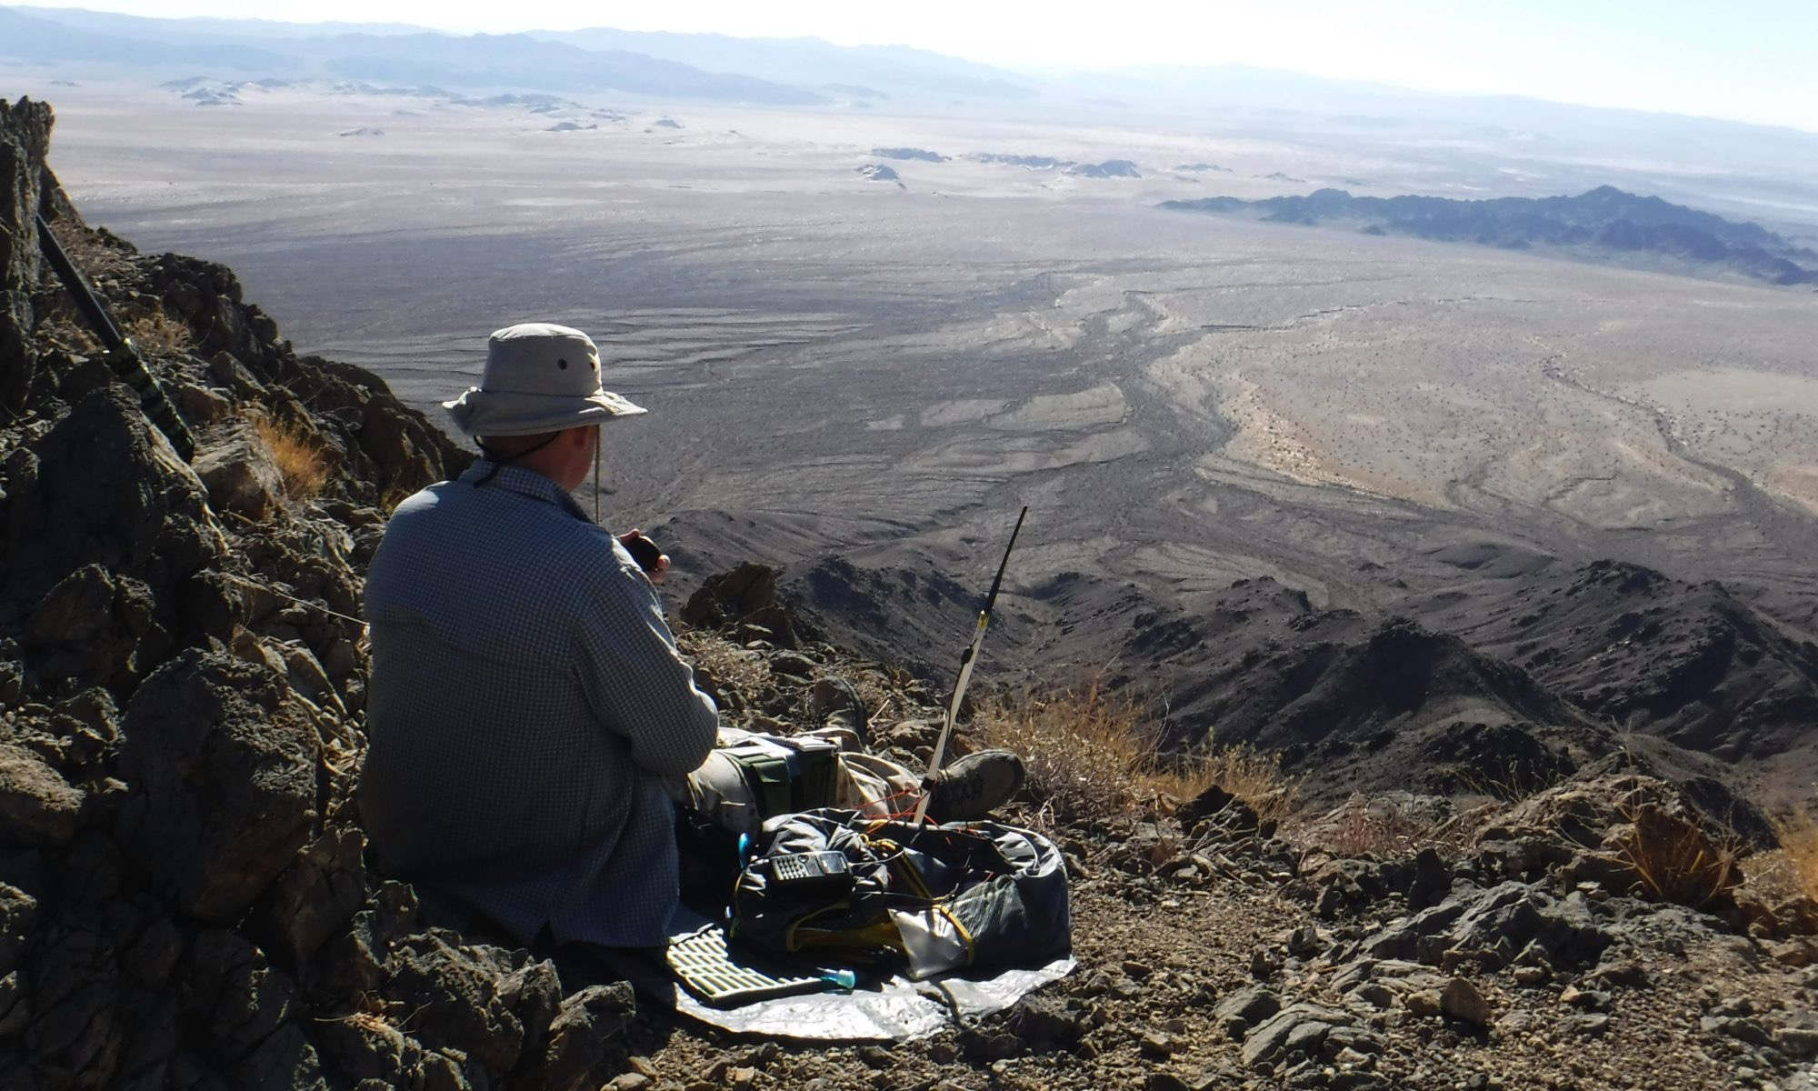
Committee:
Dewey Walker
Volunteer #2
Volunteer #3
Field Day
June 24-25

Slide 22
ARE
Ham after Eggs?
2nd & 4th Saturdays 0830-1030 Texan Kitchen 1100-0200 EPD Training Rm *Starting in April*

Slide 23
Erik
Greg
Chris
Members
Open Chat

Slide 24
Motion To Adjourn

