Slide 2
September 13, 2023

Slide 3
Introductions

Slide 4
Member Updates

Slide 5
Minutes

Slide 6
Treasurer’s Report

Slide 7
C.E.R.T Update

Slide 8
C.E.R.T Radio Shirt
EULESS CERT COMMUNICATIONS | No Pocket 10 and Up | Pocket 10 and Up | No Pocket 20 and Up | Pocket 20 and Up
S-XL | $20.50 | $26.50 | $17.00 | $23.00
XXL | $23.50 | $29.50 | $20.00 | $26.00
XXXL | $24.50 | $30.50 | $21.00 | $27.00
XXXXL | $25.50 | $31.50 | $22.00 | $28.00

Slide 9
Local Happenings

Slide 10
Euless ARC Gatherings
ERBC – Every Friday, @ 0830
Texan Kitchen 415 N Main, Euless, TX 76039
Club Social – Monday, September 18, 1800 – 1900 Lazy Dog 2521 State Highway 121, Euless, TX 76039

Slide 11
Upcoming Events
September
CERT TEAM Meeting - September 16, 0900
CPANNT Chiefs Forum Traffic Safety – Provide parking assistance and pedestrian safety. Sept 30, 2023, 8:30 – 1:30

Slide 12
Upcoming Events
October
Public Safety Open House – Oct 7, 2023, 1000 – 0200
Euless Senior Center “Junk in Your Truck” Traffic Safety – October 14, 2023, 0700 – 0130
CERT Team Radio Operations Training – Saturday, October 21, 2023, 0900 – 1200

Slide 13
Upcoming Events
November
Club Officer Elections, November 8
State Park on the Air Cabin reservation time, November 18
CERT Team Meeting - November 18 0900

Slide 14
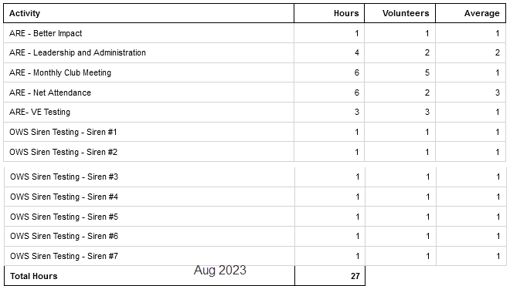
August Hours

Slide 15
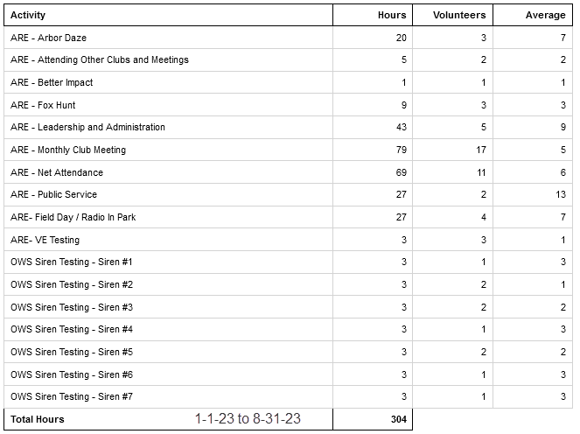
Year To Date Hours

Slide 16
Please log your hours.

Slide 17
Cabin (w/full hookups outside) $45/night + Entrance
Number of Sites: 11 People per Site: 8
Cabins 1 - 11 do not have a bathroom; they do have full hookups for RVs. A 6 percent state tax and 7 percent local occupancy tax are charged on these cabins. They have heating and air-conditioning, as well as bunk beds to sleep five. Linens and pillows are not provided. Pets are not allowed inside the cabin, but are allowed in the area. Tents or RVs are allowed outside.
Texas State Parks On The Air
Fort Richardson State Park, April 20 & 21, 2024, Reserve by November 18th

Slide 18
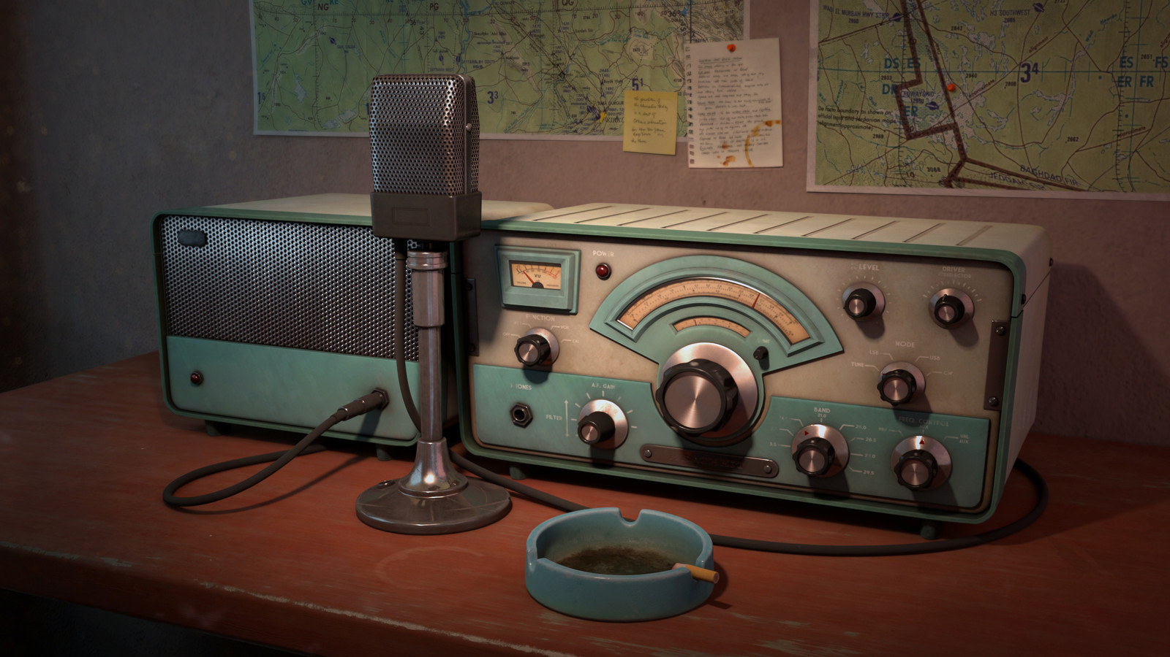
Erik
Greg
Chris
Members

Slide 19
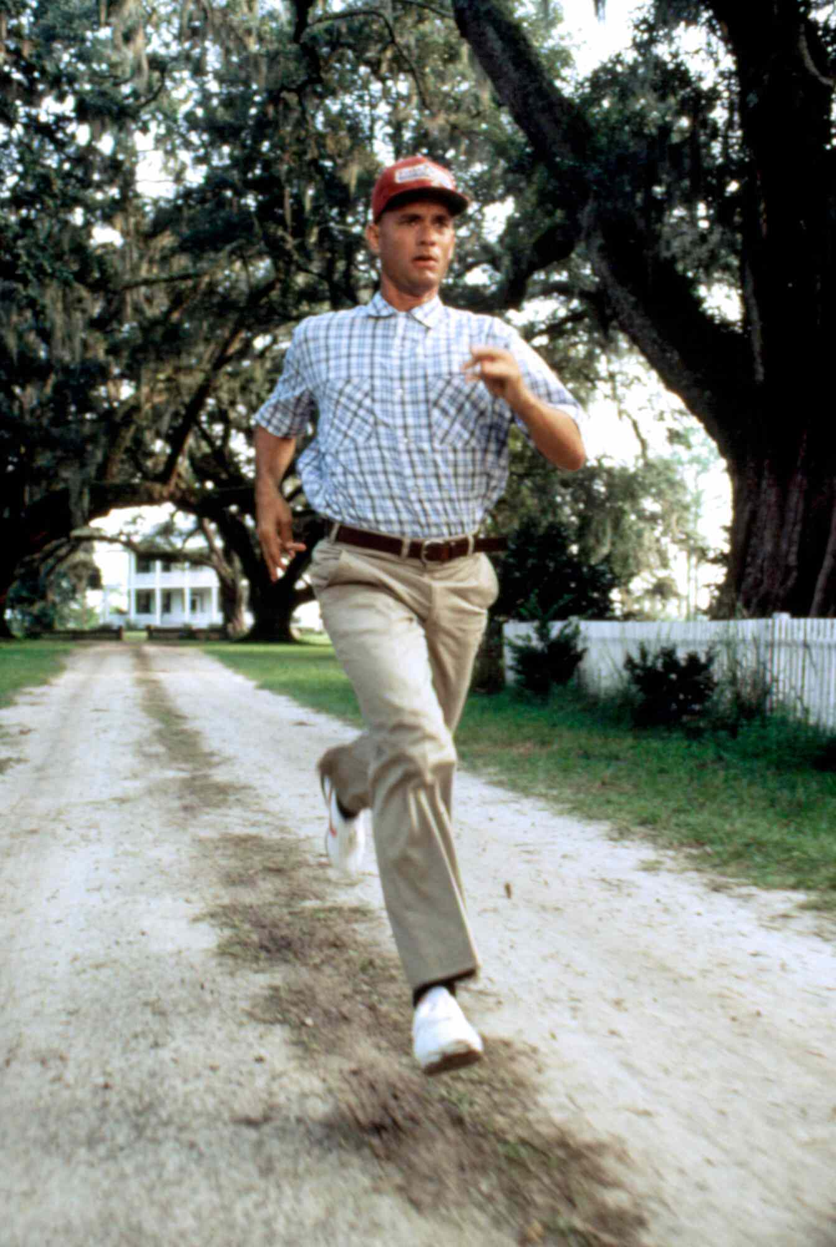
Motion To Adjourn

