Slide 2
April 16, 2025

Slide 3
Introductions

Slide 4
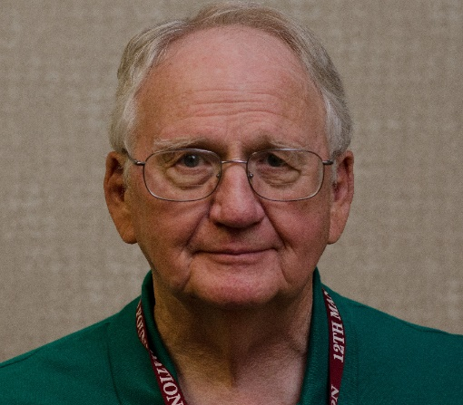
Member Updates
John Deithloff W5FFS
Silent Key

Slide 5
Minutes

Slide 6
Treasurer’s Report

Slide 7
C.E.R.T Update

Slide 8
Ham Happenings
????

Slide 9
Euless ARC Gatherings
ERBC – Every Friday, @ 0830
Texan Kitchen 415 N Main, Euless, TX 76039
H‑E‑B Joint Radio Club Breakfast, every 3rd Saturday, Egg Haven Cafe, 760 Airport Fwy, Suite 100, Hurst, RSVP by midnight Thursday
Club Social – Monday, April 21, 1800 – 1900
Panara – 2911 State Hwy 121

Slide 10
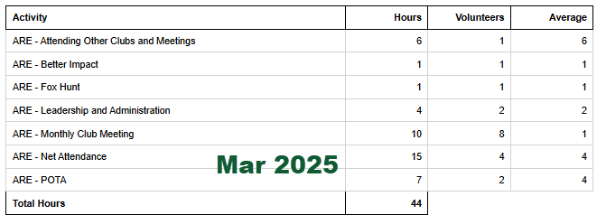
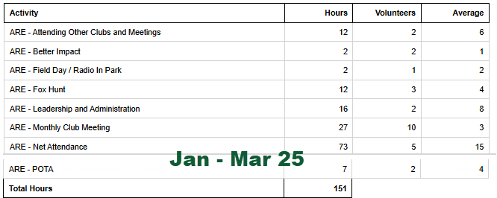
2025 Hours

Slide 11
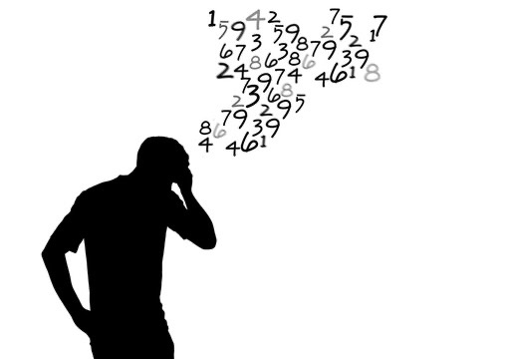
Please log your hours.

Slide 12
Planning

Slide 13
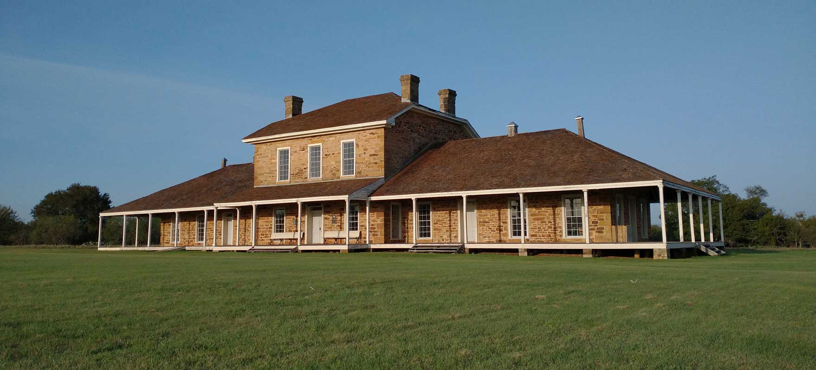
Texas State Parks On The Air
Fort Richardson State Park
April 12-13, 2025

Slide 14
Field Day
June 28-29

Slide 15
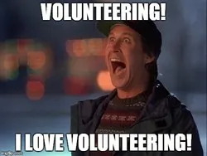
Audit Committee for 2025
Arbor Daze April 26 Need People!!!

Slide 16
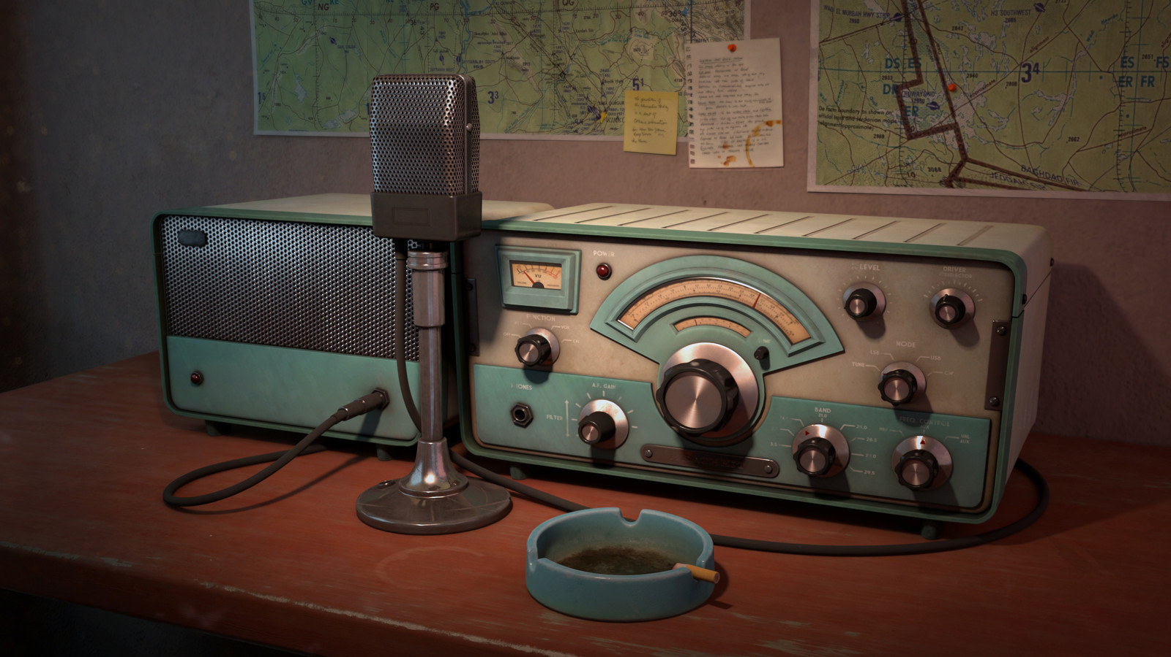
Greg
Kevin
Chris
Members

