Slide 1


Slide 2
March 12, 2025

Slide 3
Introductions

Slide 4
Member Updates

Slide 5
Minutes

Slide 6
Treasurer’s Report

Slide 7
tClub Making it Happen!
POTA – Ray Roberts
Fox Hunt
Tx On Mission – Wild Camp, NET, Hunt
W5EUL recognized on largest Ham Radio Youtube Channel
Jason Ham Radio 2.0

Slide 8
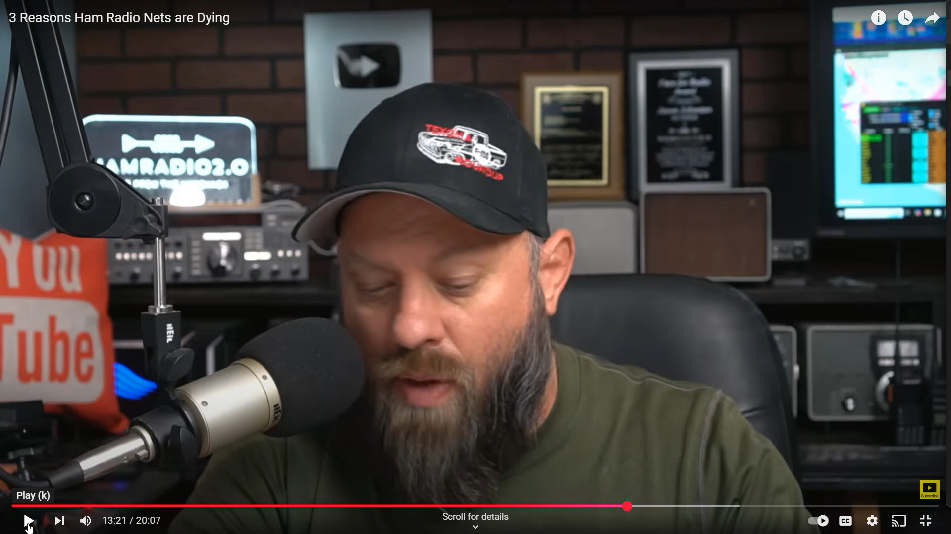

Slide 9

C.E.R.T Update

Slide 10
Local Happenings
-Belton Hamfest
April 4 & 5, 2025

Slide 11
Euless ARC Gatherings
ERBC – Every Friday, @ 0830
Texan Kitchen 415 N Main, Euless, TX 76039
H‑E‑B Joint Radio Club Breakfast, every 3rd Saturday, Egg Haven Cafe, 760 Airport Fwy, Suite 100, Hurst, RSVP by midnight Thursday
Club Social – Monday, Mar 17, 1800 – 1900
    Spring Creek BBQ Airport Freeway
Fox Hunt –

Slide 12
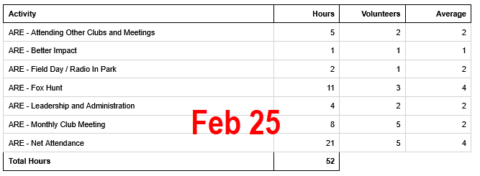
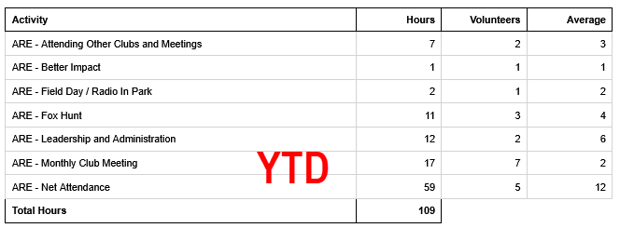
2025 Hours

Slide 13

Please log your hours.

Slide 14

Planning

Slide 15

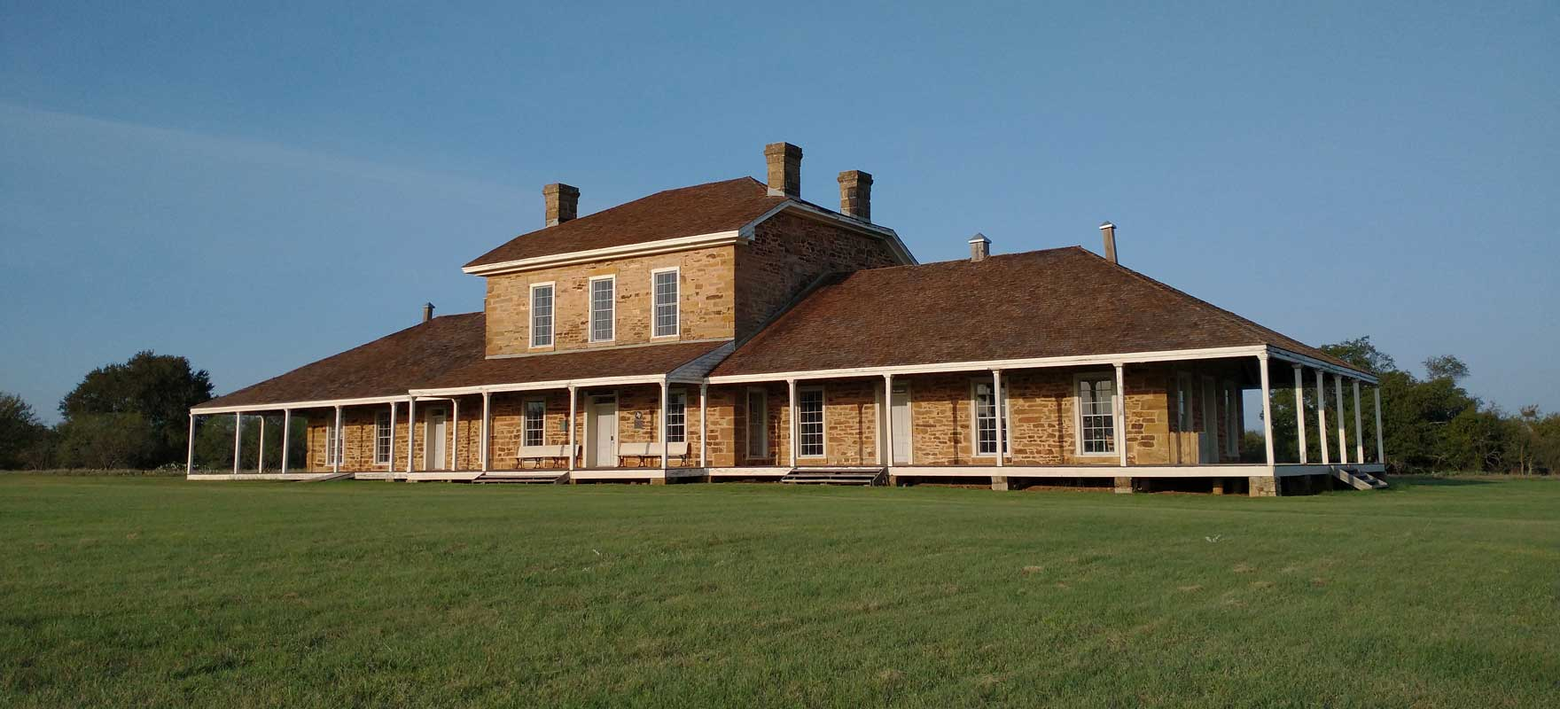
Texas State Parks On The Air
Fort Richardson State Park
April 12-13, 2025

Slide 16

Field Day
June 28-29

Slide 17


Audit Committee for 2025
Arbor Daze April 26 Need People!!!

Slide 18
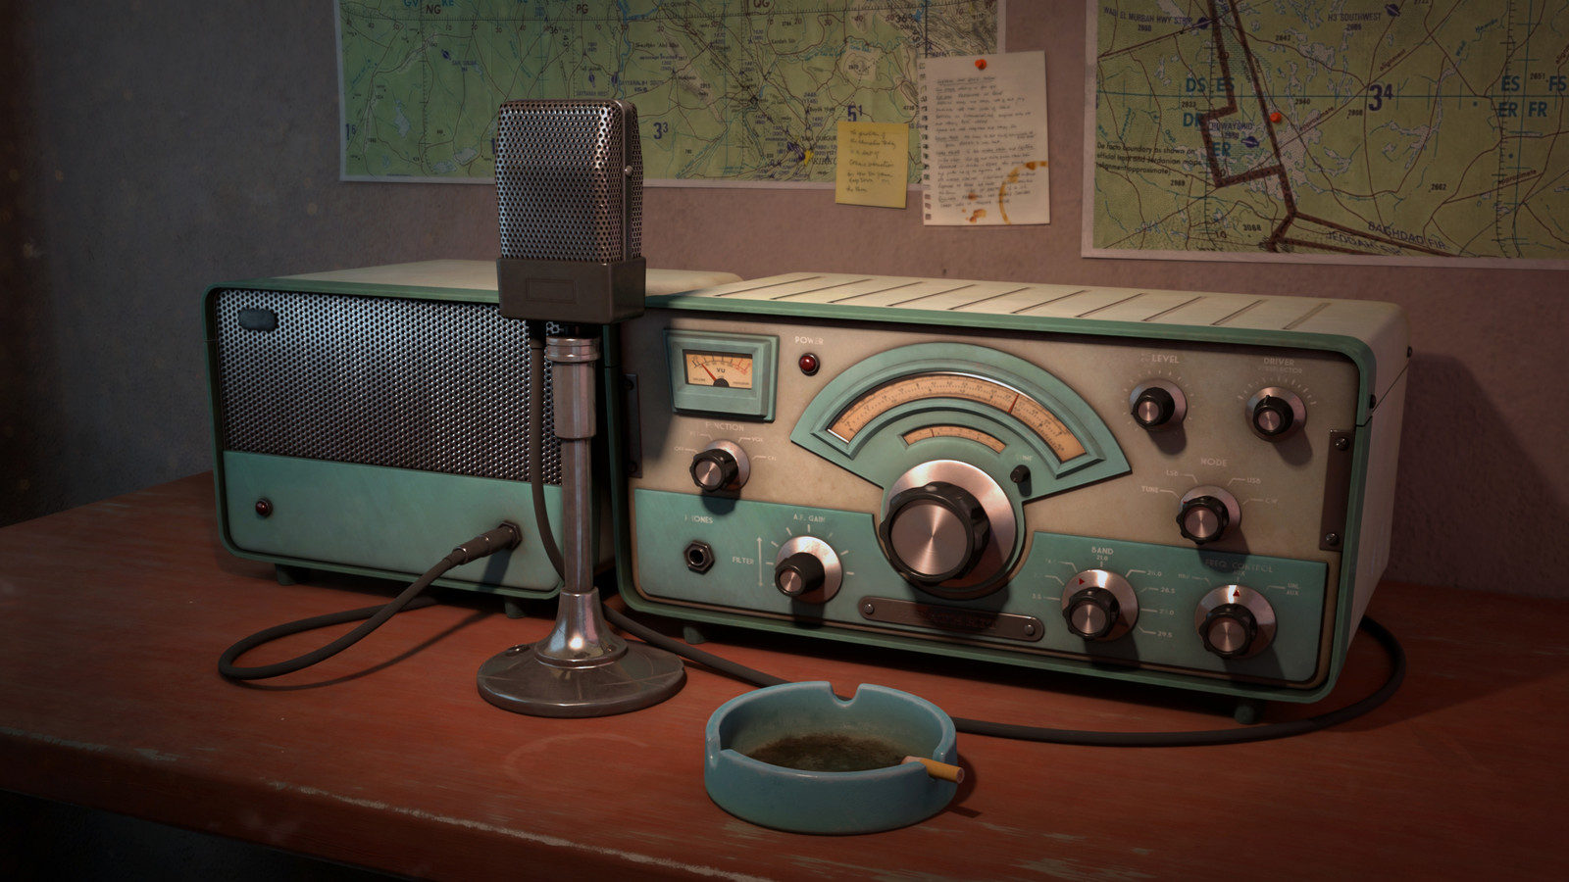
Greg
Kevin
Chris
Members

